Slide 1
Tutor Training

Slide 2
Welcome!
Today’s goals:
Discussing our vision on student counseling and the role of the Thermos dashboard.
Guiding a conversation with a student using the Thermos dashboard through deploying the T-GROW model.
Planning:
Activity 1: Role of tutor
activity 2: Practice conversation
Plenary ending.

Slide 3
Activity 1: Role of Tutor

Slide 4
Cases
Exercise: We are going to discuss different cases of students who come to you for a conversation about their dashboard. The main questions for each case are: What is your role as mentor? Do you refer the student onwards to others for support (e.g., student counselor, skillslab) or not?

Slide 5
Case 1
“I am really worried about the upcoming exams. To feel less stressed, I go out to do other things and not think about it. I actually don’t know if I can handle this study, so I recognize that in my self-belief score.”

Slide 6
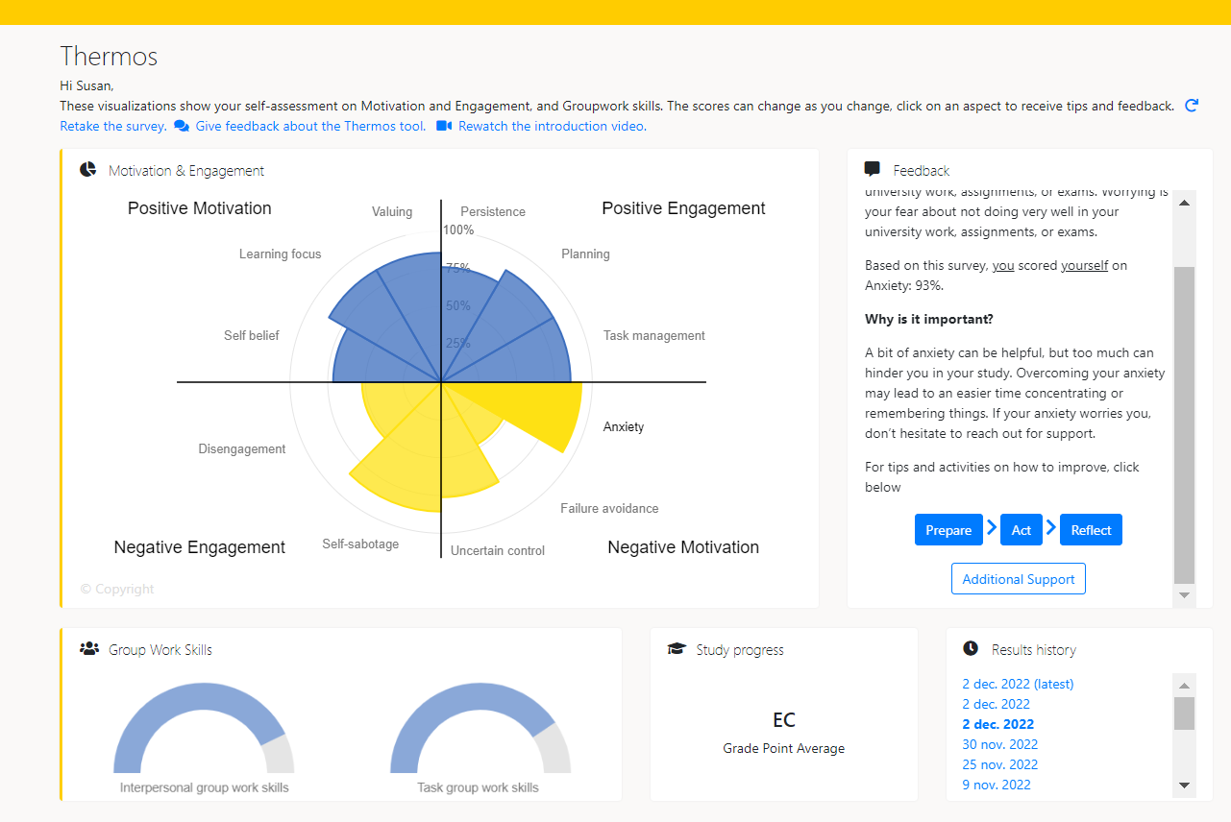

Slide 7
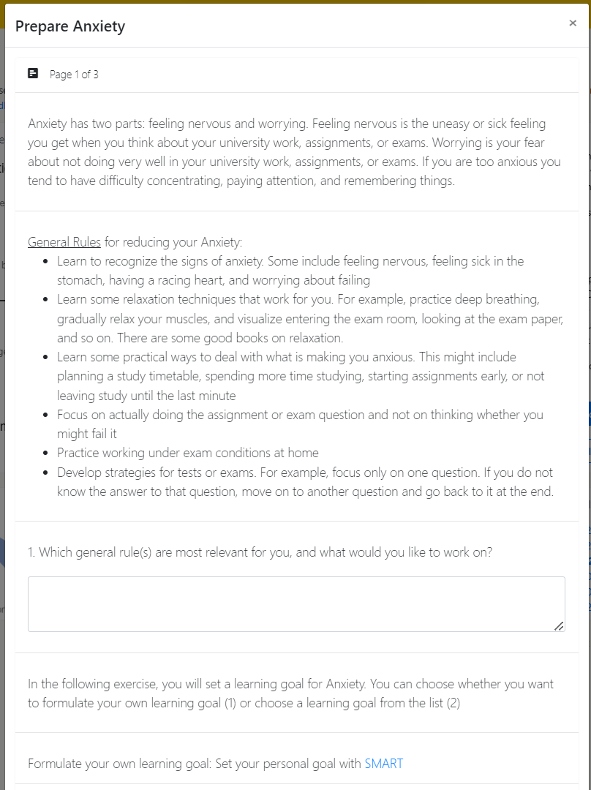
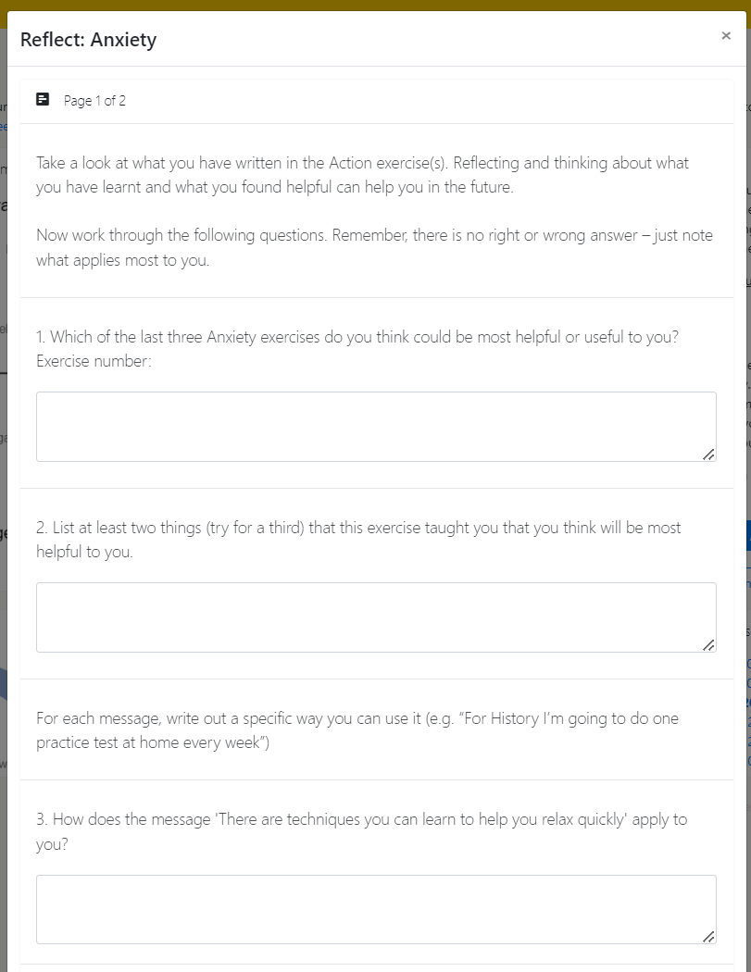
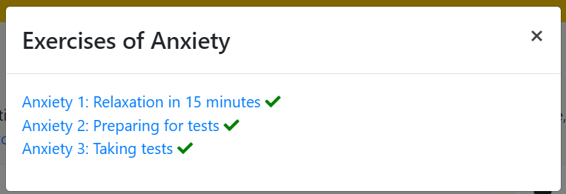
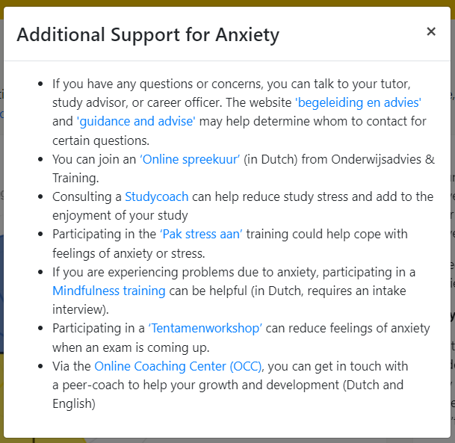

Slide 8
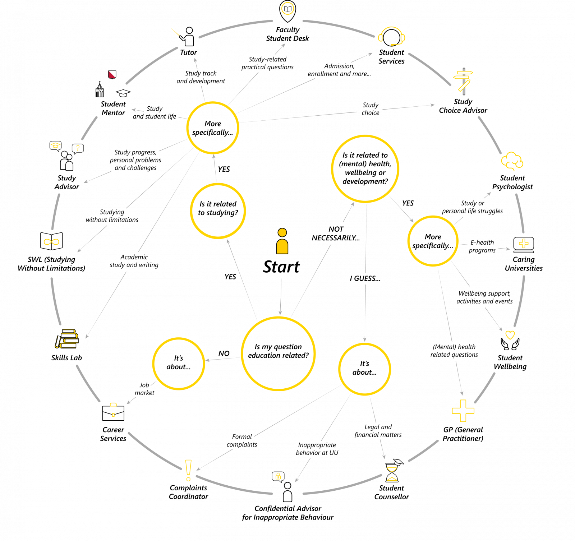

Slide 9
Case 2
“I’m not satisfied with my planning score. I’m having trouble with balancing my study, with my private life. If my friends want to hang out or if work asks me to fill in for sick collegues, I find it hard to say no.”

Slide 10
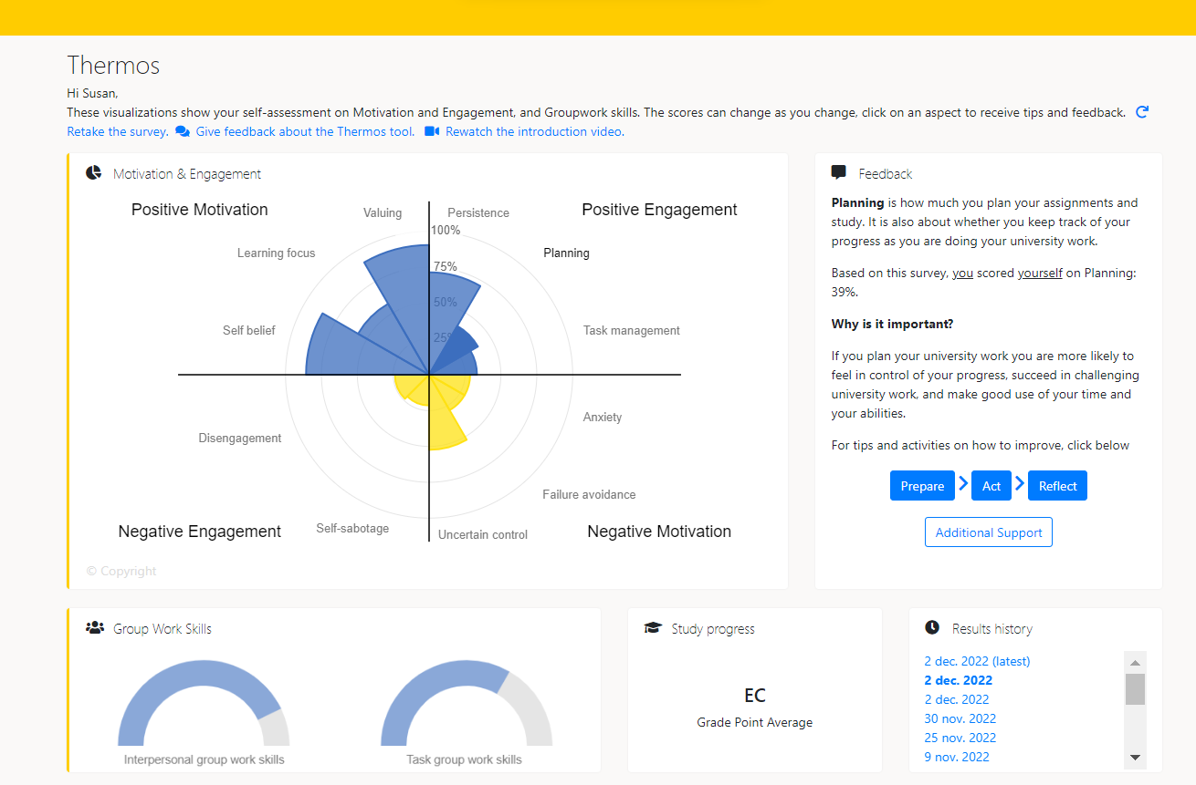

Slide 11
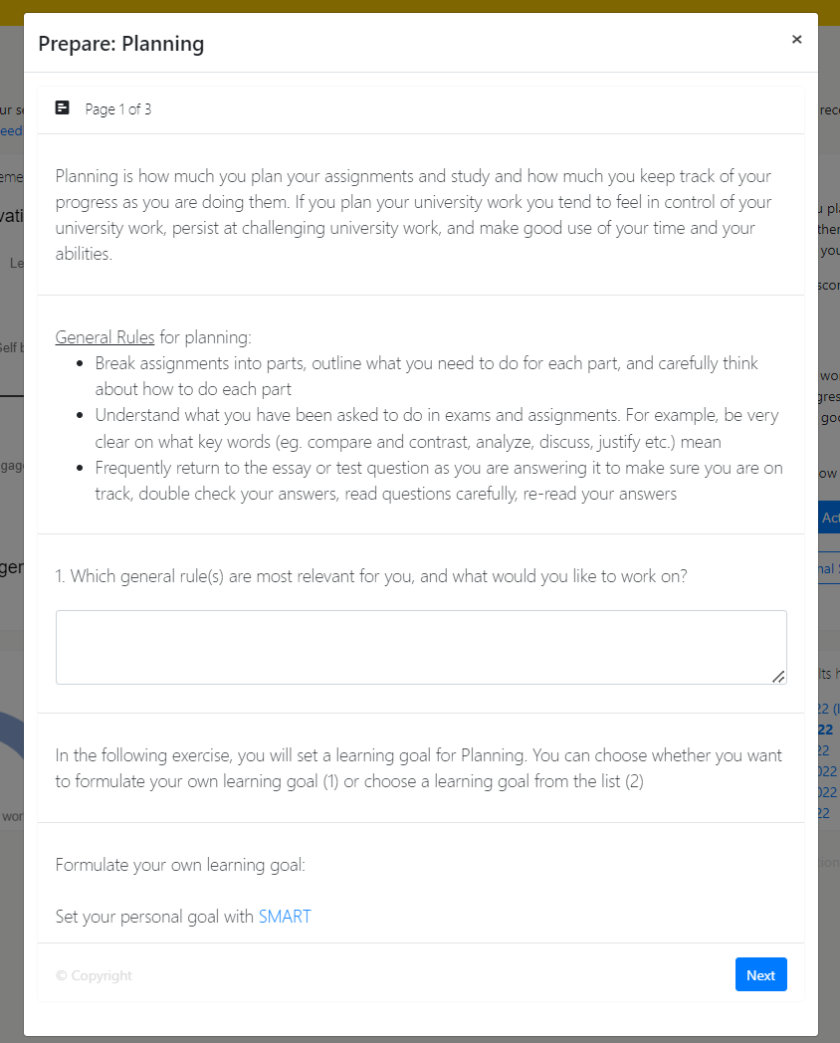
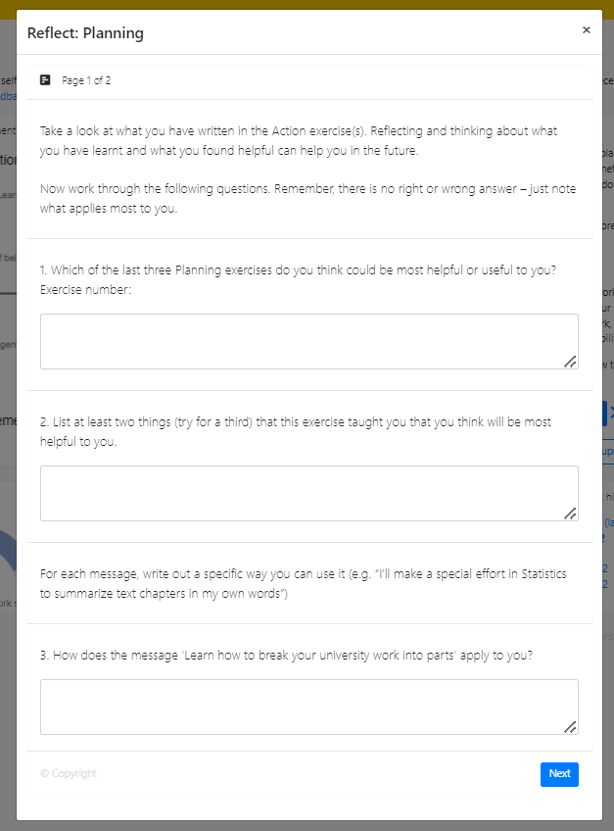
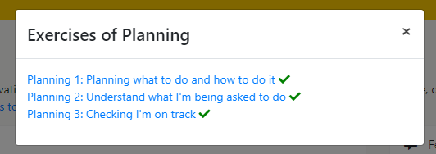
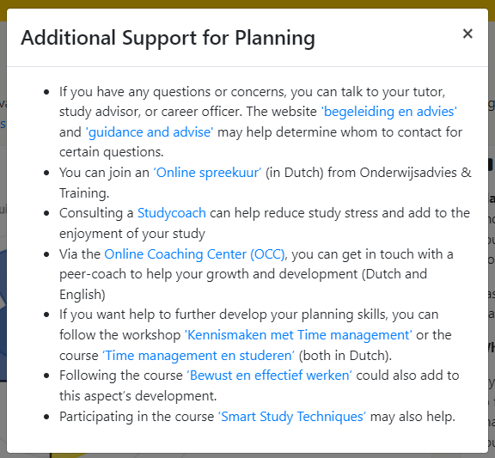

Slide 12
Discussion and Questions
First reactions?
Questions:
What is your role as mentor?
When do you need to acknowledge the expertise of others?

Slide 13
Please note!
Important: GDPR (AVG) – data in the dashboard belongs to the student.
Don’t ask ‘What was your score on Planning?’ or ‘Can you show me your dashboard?’.
Do ask:
‘What did you notice about your scores?’ or
‘What do you want to share about your visualizations?’ or
‘Did you recognize yourself in the scores?’
‘What do you want to work on and how can I help?’
So no one gets in trouble ☺
Notes:
Lotte: evt. nog benoemen, vorige keer ook al wel genoemd.
Niet vragen naar planning: dashboard is van student, niet forceren om te laten zien (onder druk gezet voelen). Moet vrijwillig zijn.

Slide 14
Break!

Slide 15
Activity 2: Practice Conversation

Slide 16
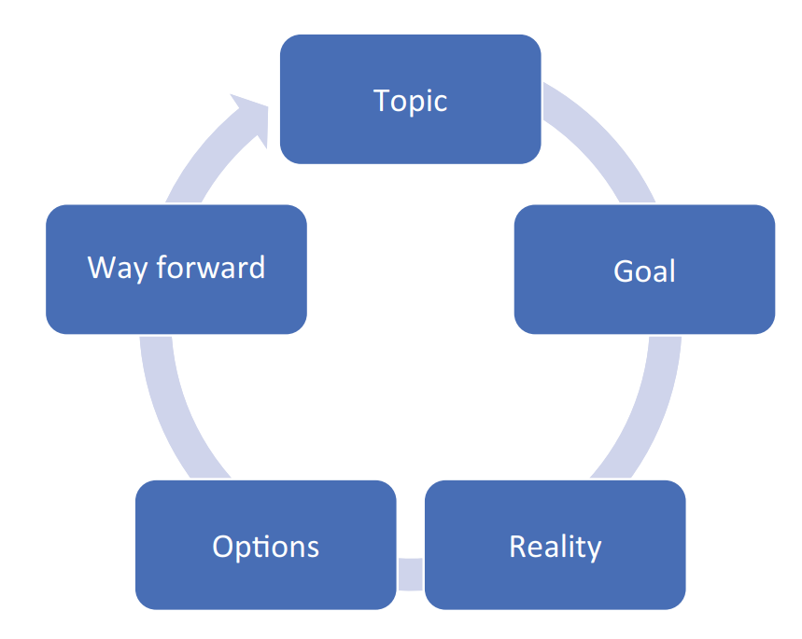
T-GROW Coaching Model
Phase 0: Topic
Phase 1: Establishing the Goal
Phase 2: Exploring the Current Reality
Phase 3: Generating and Evaluating Options
Phase 4: Wrap-Up/Will/Way Forward
Note: try to let the students guide the conversation and
encourage them to think about possibilities on their own.
Passmore, J., & Sinclair, T. (2020). Chapter 15: Behavioral Approach and the GROW Model. In Becoming a Coach: The Essential ICF Guide (1st ed., pp. 113–118). Springer. https://doi.org/10.1007/978-3-030-53161-4

Slide 17
Phase 0: Topic
Establish the topic of the conversation. What does the student want to talk about?
Phase 1: Establishing the Goal
Formulate a concrete goal. What does the student want to achieve?
Phase 2: Exploring the Current Reality
Reflect on the current situation. What are the possible causes, effects, and blockages? What has already been tried?
Phase 3: Generating and Evaluating Options
First brainstorm on all possible options, then evaluate these options to come up with the best-suited option.
Phase 4: Wrap-Up/Will/Way Forward
Create an action plan. What steps will the student take to achieve this goal? And what support is needed to do so?

Slide 18
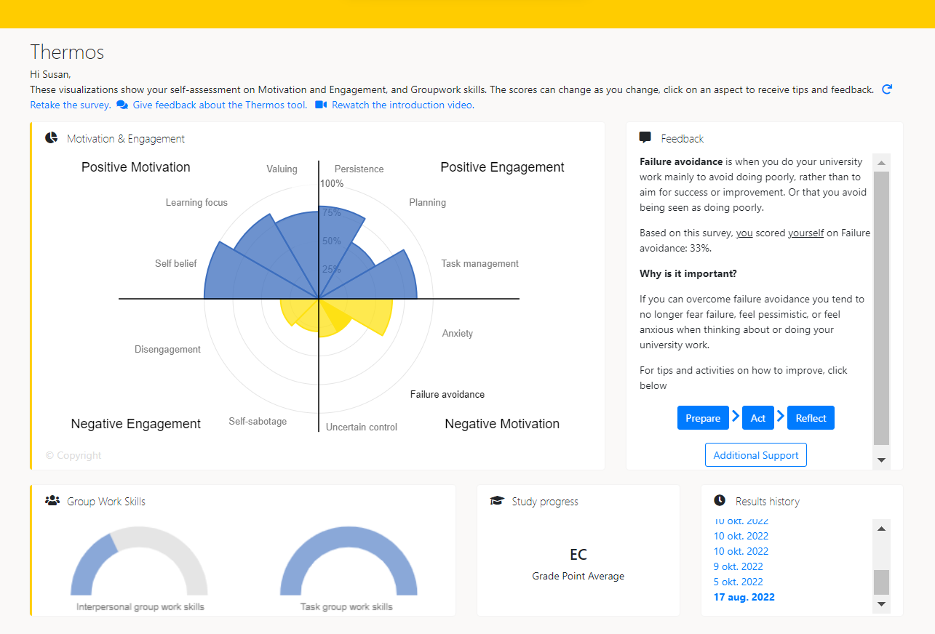
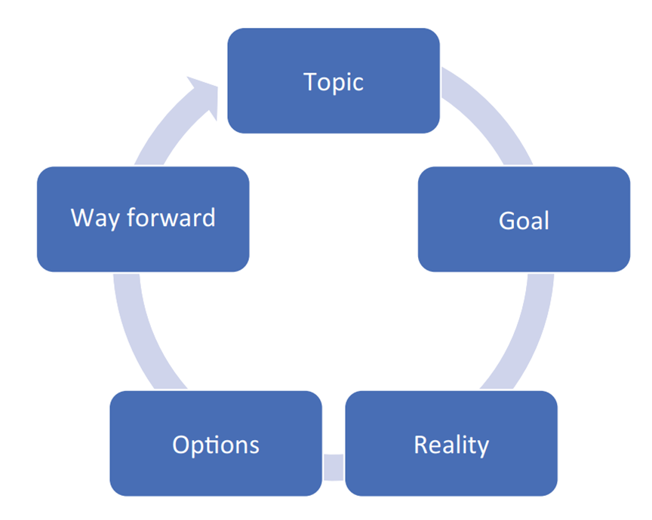
Working with the T-Grow model & Thermos-dashboard
Exercise: One on one conversation with student who has used the dashboard
Role play: 1 tutor, 1 ‘student’
Practice conversation in pairs, using the T-GROW Model (10 min)
Next, also in pairs, think about and discuss (5 min);
What can you ask a student? What shouldn’t you ask a student?
What is helpful for a student?
Let’s go!

Slide 19
Discussion and Questions
First reactions?
Questions:
Was the T-GROW model helpful for guiding a student?
What can you ask a student? What shouldn’t you ask a student?
What is helpful for a student?

Slide 20
Please note!
Important: GDPR (AVG) – data in the dashboard belongs to the student.
Don’t ask ‘What was your score on Planning?’ or ‘Can you show me your dashboard?’.
Do ask:
‘What did you notice about your scores?’ or
‘What do you want to share about your visualizations?’ or
‘Did you recognize yourself in the scores?’
‘What do you want to work on and how can I help?’
So no one gets in trouble ☺

Slide 21
Closing remarks
Thank you for participating!
For questions, please contact (..)

