Slide 1
Activity: Practice Conversation

Slide 2
Welcome!
Today’s goal: Guiding a conversation with a student using the Thermos dashboard through deploying the T-GROW model.
Planning
Discussing T-Grow Coaching Model
Activity practice conversation
Discussion and questions

Slide 3
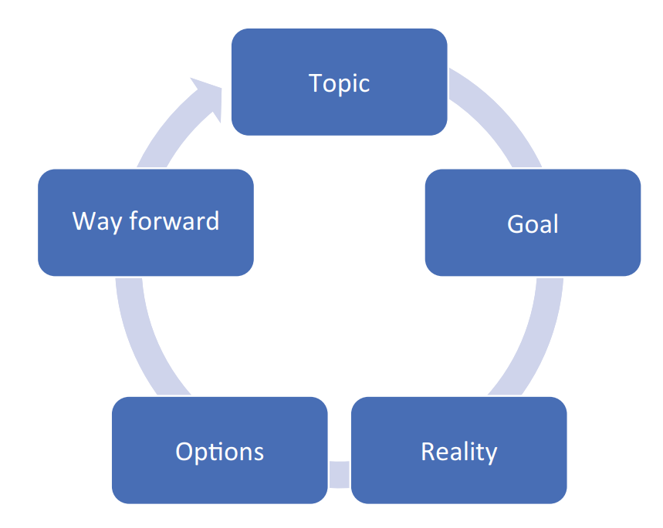
T-GROW Coaching Model
Phase 0: Topic
Phase 1: Establishing the Goal
Phase 2: Exploring the Current Reality
Phase 3: Generating and Evaluating Options
Phase 4: Wrap-Up/Will/Way Forward
Note: try to let the students guide the conversation and
encourage them to think about possibilities on their own.
Passmore, J., & Sinclair, T. (2020). Chapter 15: Behavioral Approach and the GROW Model. In Becoming a Coach: The Essential ICF Guide (1st ed., pp. 113–118). Springer. https://doi.org/10.1007/978-3-030-53161-4

Slide 4
Phase 0: Topic
Establish the topic of the conversation. What does the student want to talk about?
Phase 1: Establishing the Goal
Formulate a concrete goal. What does the student want to achieve?
Phase 2: Exploring the Current Reality
Reflect on the current situation. What are the possible causes, effects, and blockages? What has already been tried?
Phase 3: Generating and Evaluating Options
First brainstorm on all possible options, then evaluate these options to come up with the best-suited option.
Phase 4: Wrap-Up/Will/Way Forward
Create an action plan. What steps will the student take to achieve this goal? And what support is needed to do so?

Slide 5
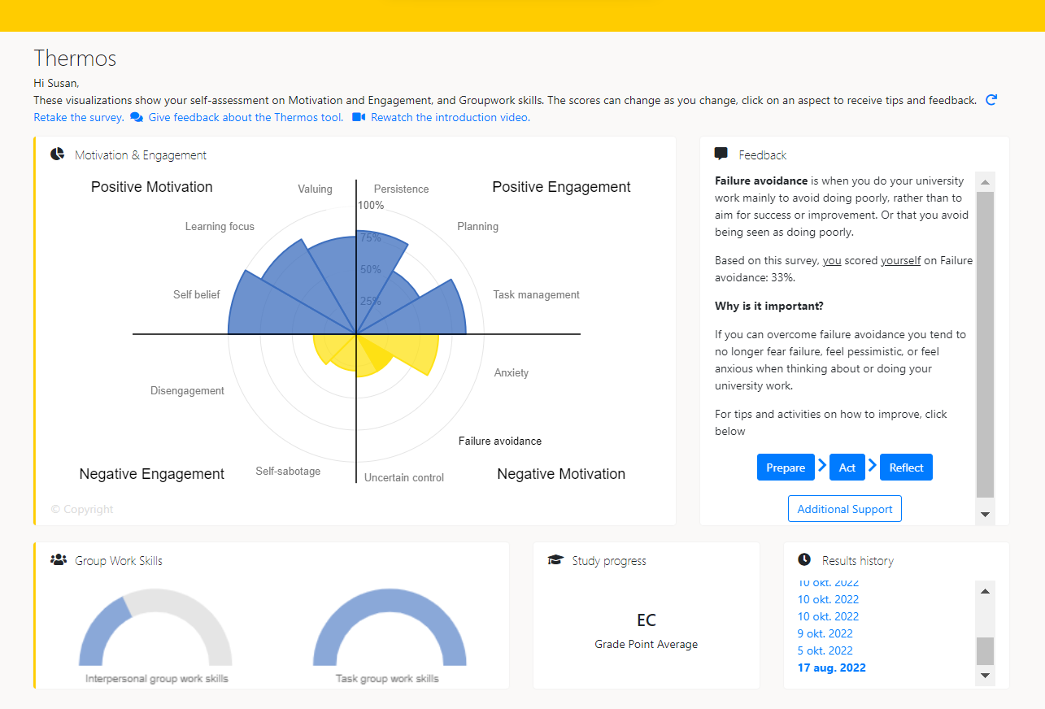
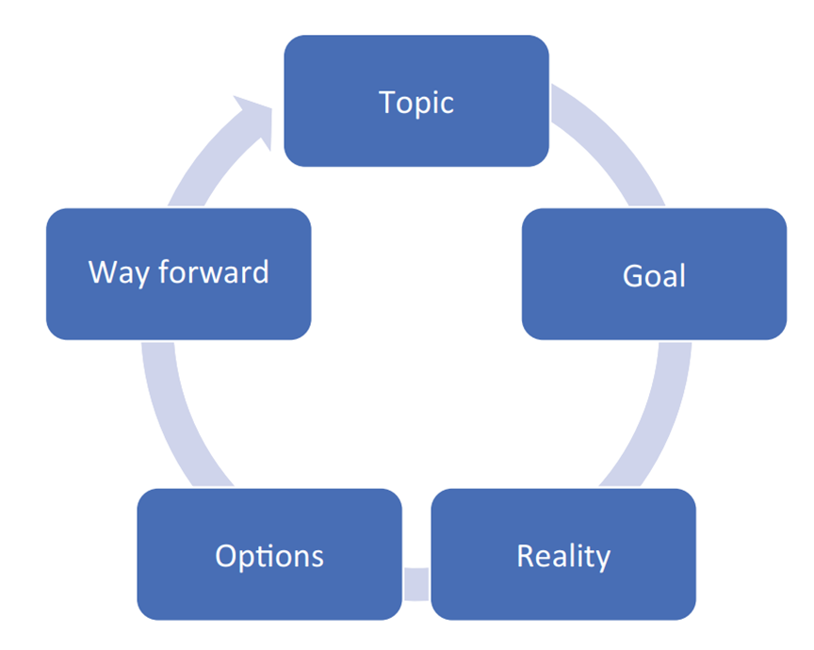
Working with the T-Grow model & Thermos-dashboard
Exercise: One on one conversation with student who has used the dashboard
Role play: 1 tutor, 1 ‘student’
Practice conversation in pairs, using the T-GROW Model (10 min)
Next, also in pairs, think about and discuss (5 min);
What can you ask a student? What shouldn’t you ask a student?
What is helpful for a student?
Let’s go!

Slide 6
Discussion and Questions
First reactions?
Questions:
Was the T-GROW model helpful for guiding a student?
What can you ask a student? What shouldn’t you ask a student?
What is helpful for a student?

Slide 7
Please note!
Important: GDPR (AVG) – data in the dashboard belongs to the student.
Don’t ask ‘What was your score on Planning?’ or ‘Can you show me your dashboard?’.
Do ask:
‘What did you notice about your scores?’ or
‘What do you want to share about your visualizations?’ or
‘Did you recognize yourself in the scores?’
‘What do you want to work on and how can I help?’
So no one gets in trouble ☺

Slide 8
Closing remarks
Thank you for participating!
For questions, please contact (..)

